Slide 1

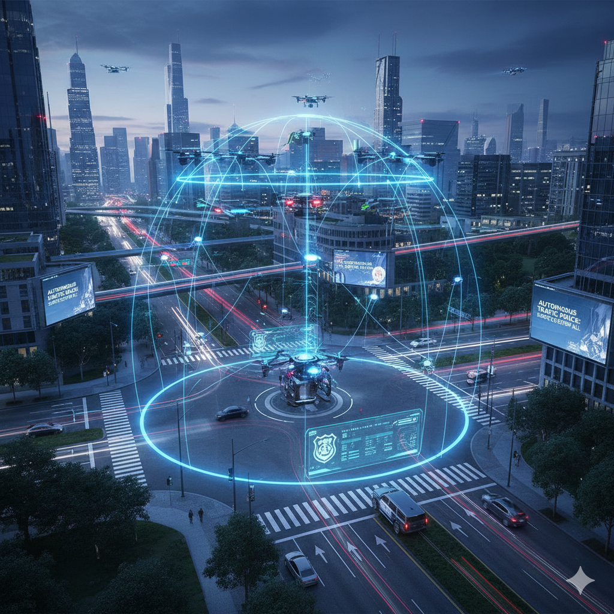





Autonomous Traffic Police Management System
Digitalization of Sri Lanka Traffic Police task to provide and accuracy and effective service for all parties
Progress Presentation 01
Group ID - 25-26J-300
01

Slide 2

INTRODUCTION
Problem and Impact
Most of legal cases are delay because of the lack of evidence.
Fine procedure is very time cost in Sri Lanka.
Traffic management of Sri Lanka is very primary level and most of time are ruined for people because of heavy traffic.
People are not aware about law is the severe reason of our country
Design excellence of overall solution
Multi-modal AI using images, fines and victim data, and reduce to people tend to do wrong things in roads.
Explainable AI for legal and law related for understand people
Traffic light controlling, fine calculating and support to evidence effectively manage.
Who while be benefited by the solution
Peoples who are fined without any false
To same time effective people
Digitalization of traffic police tasks beneficiary for both
06/01/2026
03

Slide 3


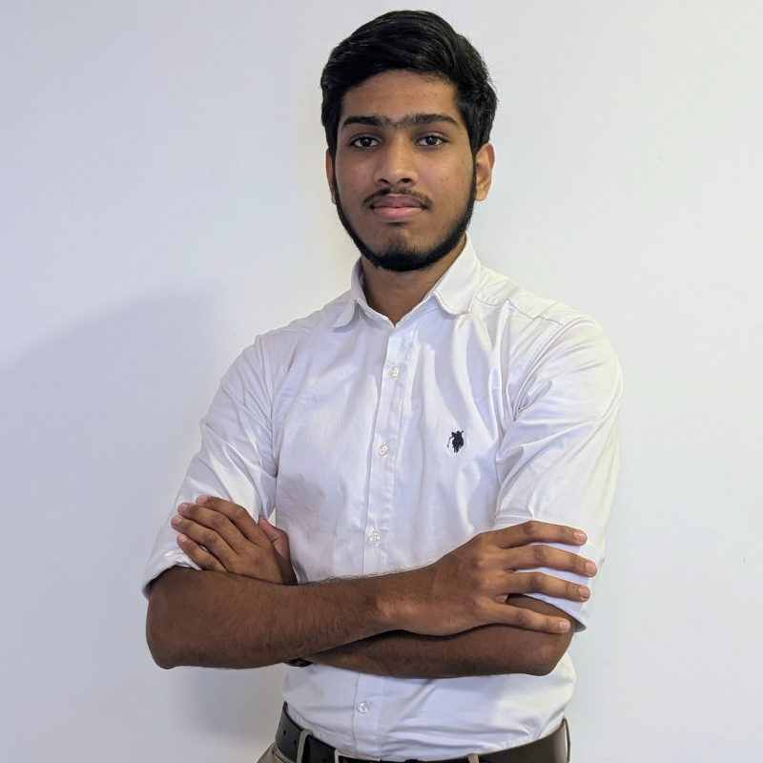

INDUWARA YGY
IT22642332
Specialization - Information Technology
EVIDENCE MANAGEMENT
IT22642332 | INDUWARA.Y.G.Y | 25-26J-300
06/01/2026
03

Slide 4
EVIDENCE MANAGEMENT
How the Solution will address the Sub-Problem / Prototype
User Requirements addressed by the solution
Police officer fines the victim
Upload evidence that related to fine can be upload both police officer and victim
Court has read based access to every evidence
Preventing AI generated evidence upload using ML verification system
Also evidence can upload motions, pleadings and also can rewrite properly using AI system
Most of the legal cases are disqualifies because lack of the evidences
This is the severe case that the victims are not challenge the police decision if it is correct or wrong
This component will address this issue from secure evidence management for each fines
IT22642332 | INDUWARA YGY | 25-26J-300
06/01/2026
04
Notes:
6

Slide 5
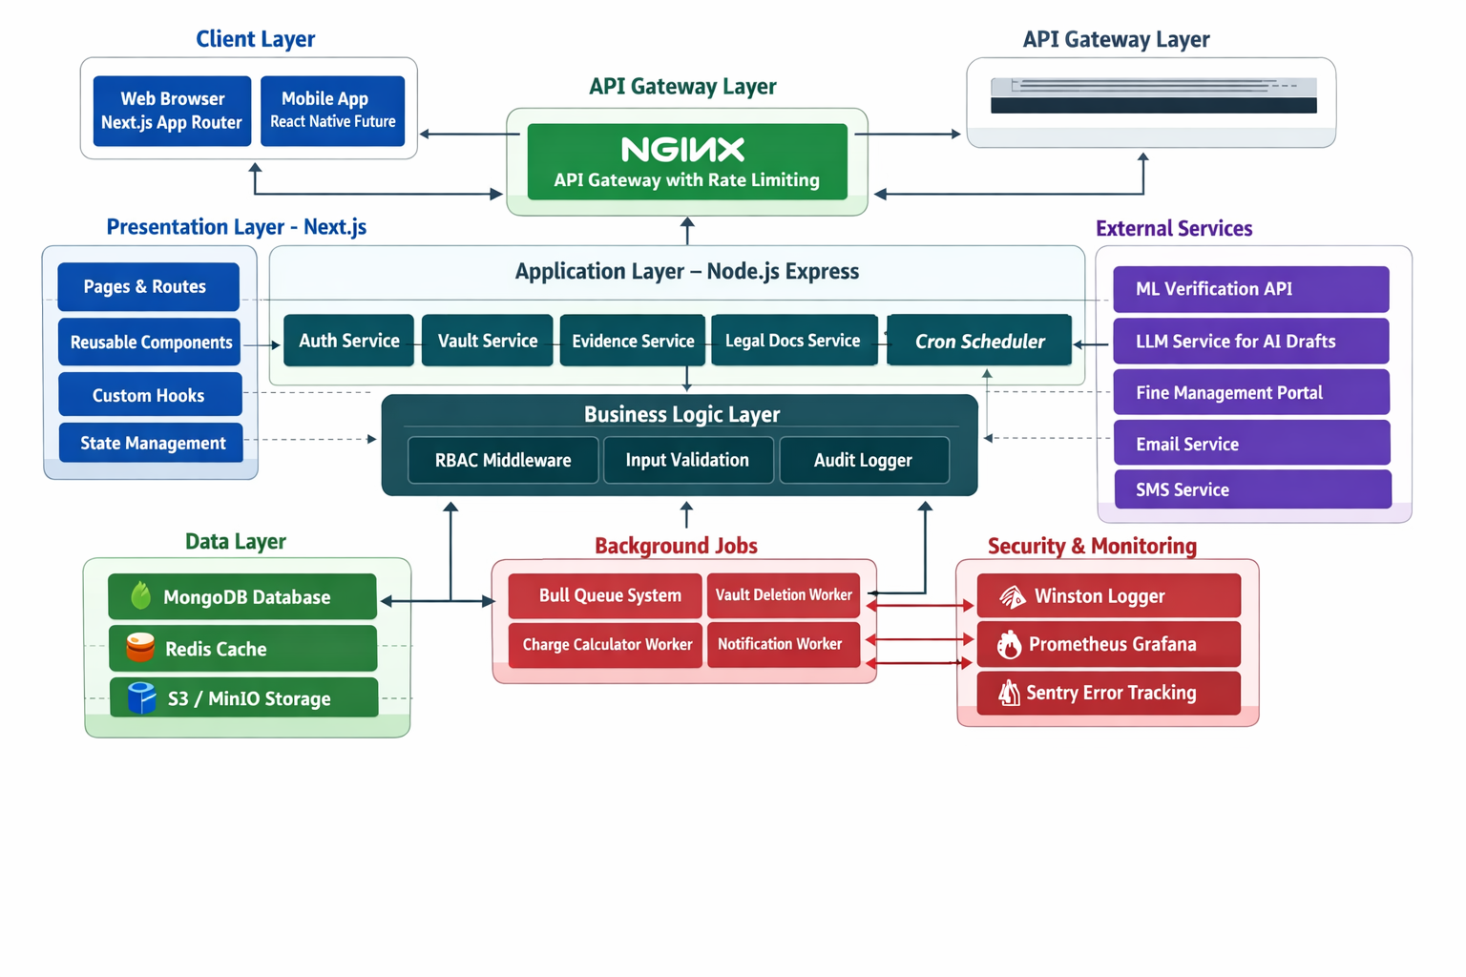
EVIDENCE MANAGEMENT ARCHITECTURE
IT22642332 | INDUWARA YGY | 25-26J-300
06/01/2026
05
Notes:
7

Slide 6
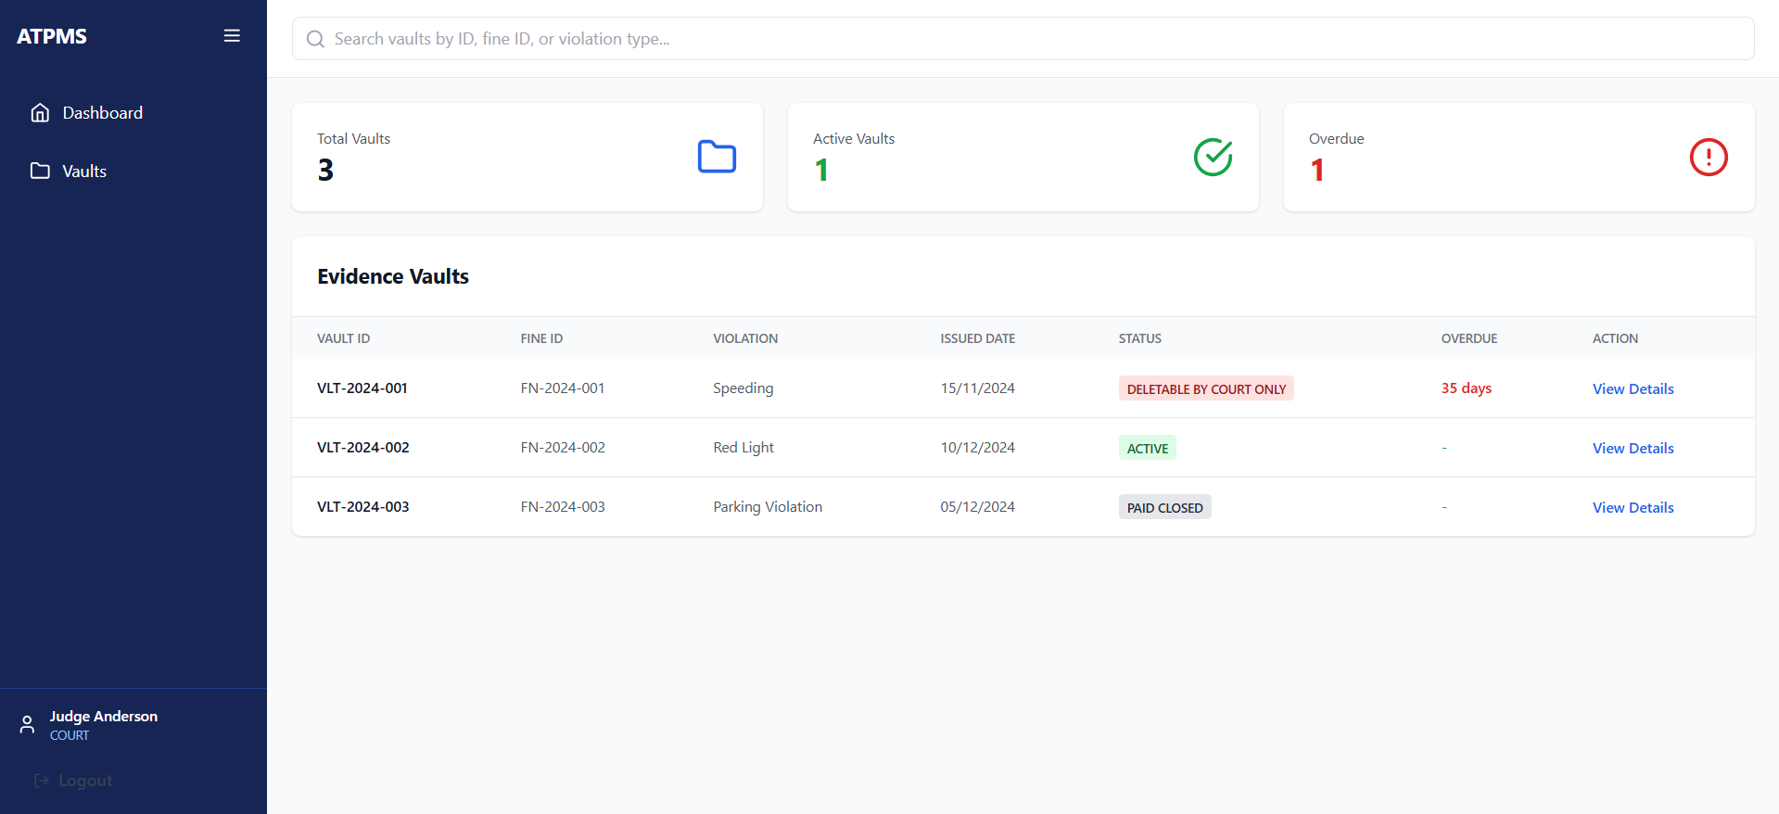
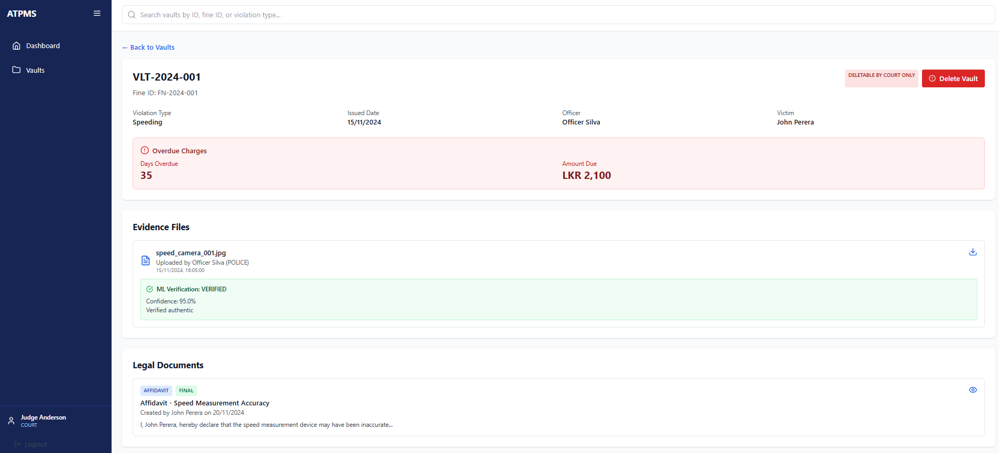
EVIDENCE MANAGEMENT DEMO
IT22642332 | INDUWARA YGY | 25-26J-300
06/01/2026
06
Notes:
7

Slide 7


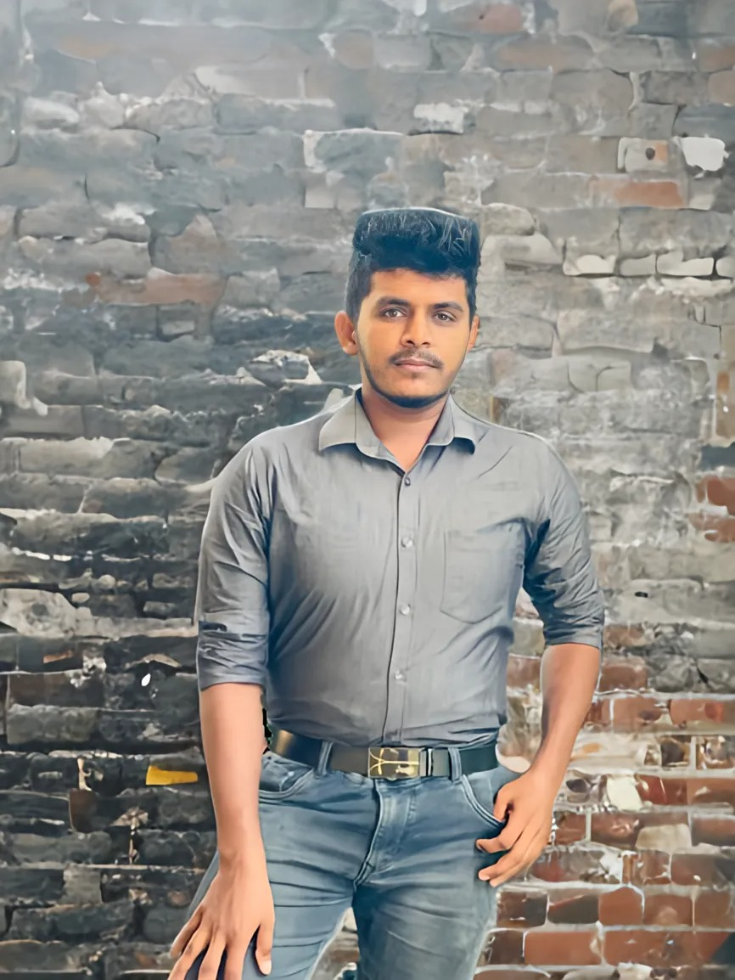
Lakshan W V D
IT22560308
Specialization - Information Technology
Real-Time Traffic Monitoring, Prediction, and Emergency Path Optimization
IT22560308 | Lakshan W V D | 25-26J-300
07/01/2026
07

Slide 8
Real-Time Traffic Monitoring, Prediction, and Emergency Path Optimization
How the Solution will address the Sub-Problem / Prototype
User Requirements addressed by the solution
Real-time cameras adjust signal intervals based on traffic.
Connected junctions synchronize signals to prevent traffic bottlenecks.
Google Maps dashboard monitors live density and signal locations.
Simulation tools test signal logic before real-world deployment.
IoT maps provide live visual monitoring of traffic congestion.
Emergency vehicles get priority via automatic signal clearing.
Adaptive timing reduces wait times and speeds up commutes.
Predictive data helps optimize police officer deployment.
IT22560308 | Lakshan W V D | 25-26J-300
07/01/2026
08
Notes:
6

Slide 9
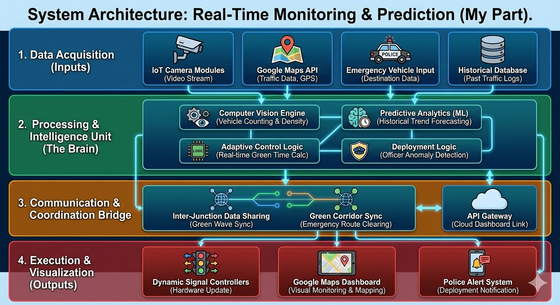
Real-Time Traffic Monitoring, Prediction, and Emergency Path Optimization Architecture
IT22560308 | Lakshan W V D | 25-26J-300
07/01/2026
09

Slide 10
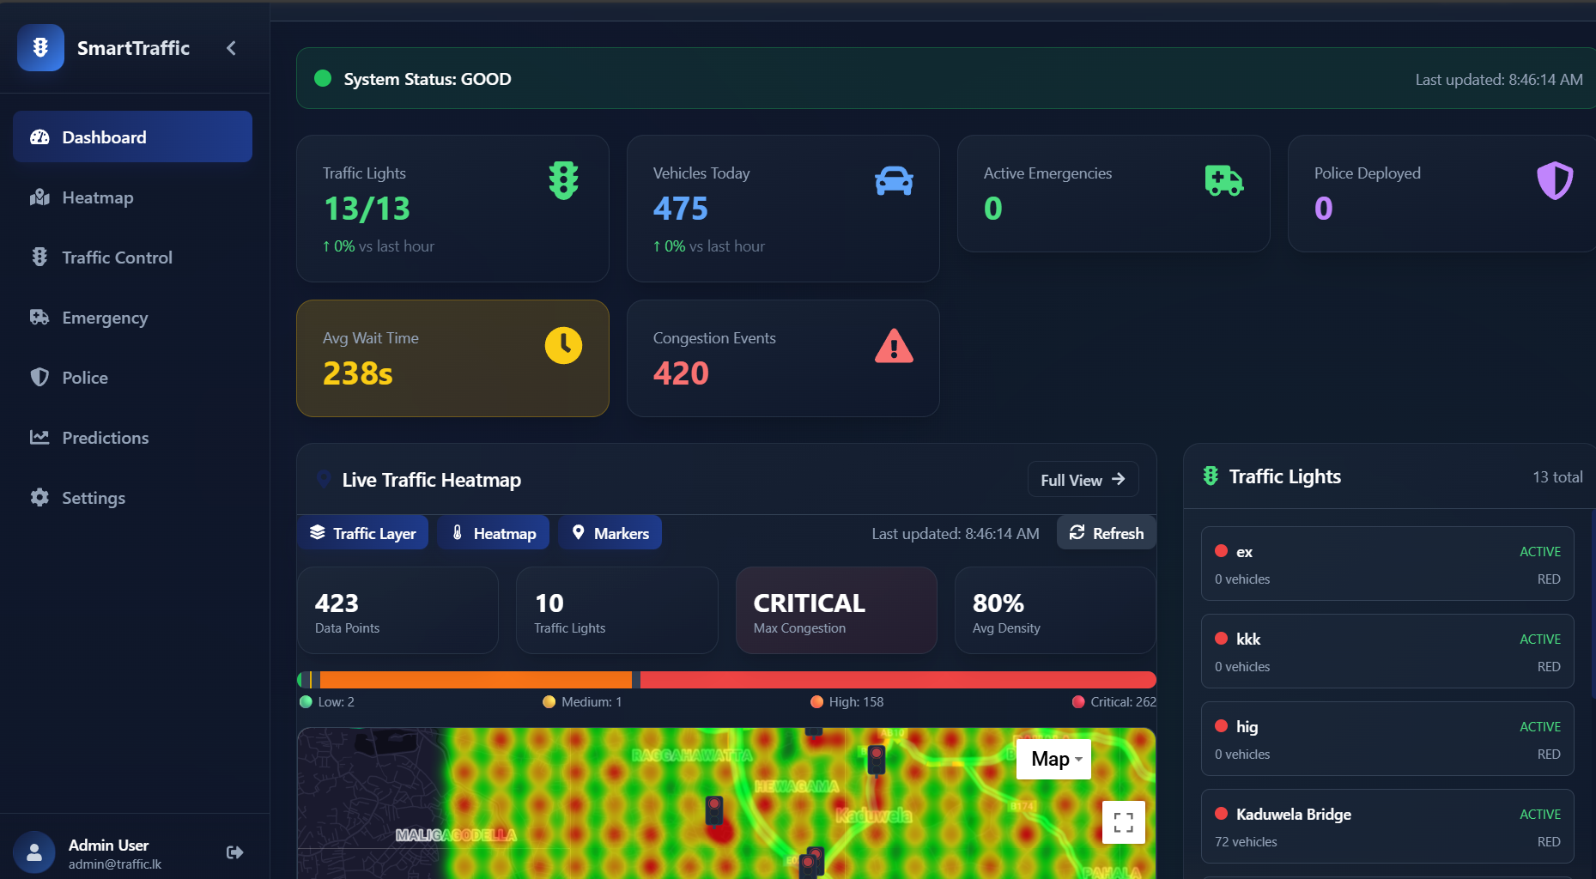
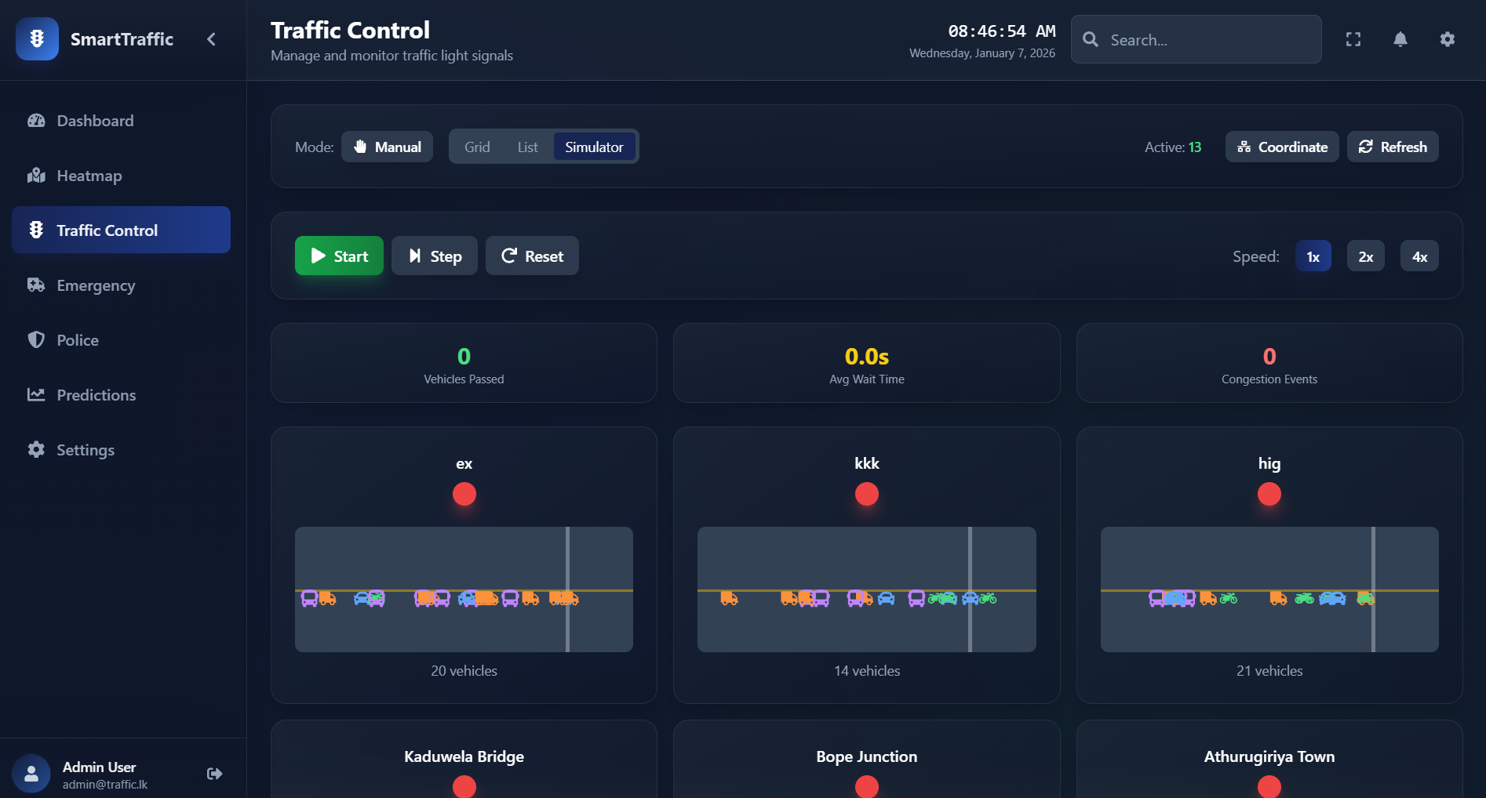
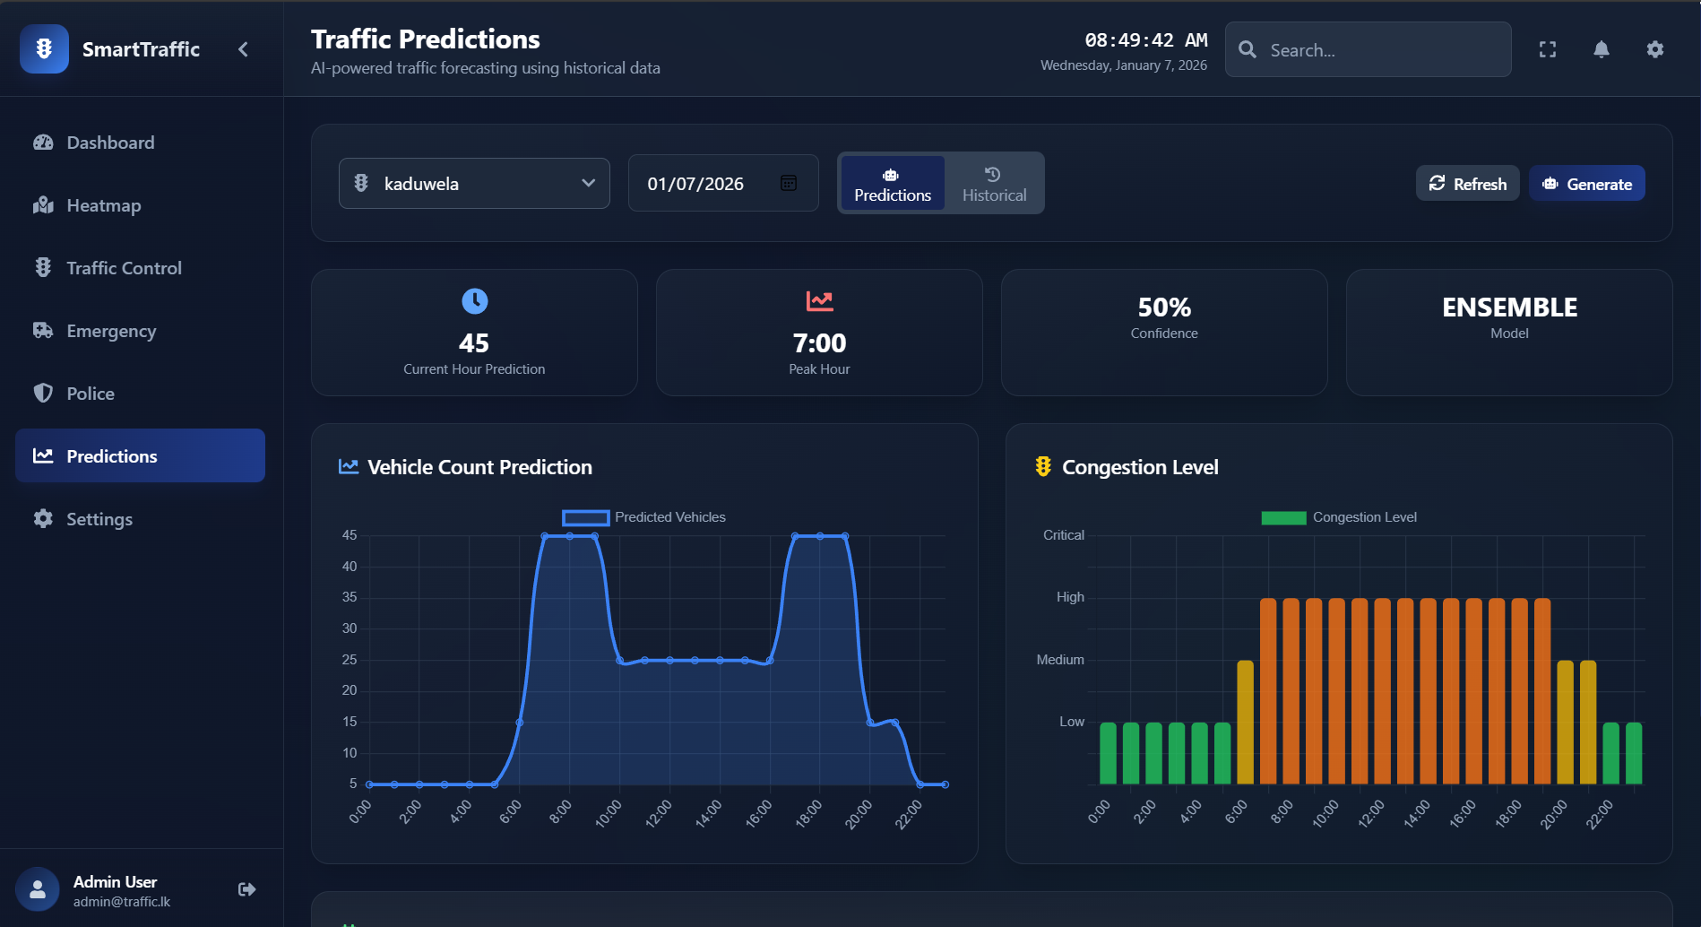
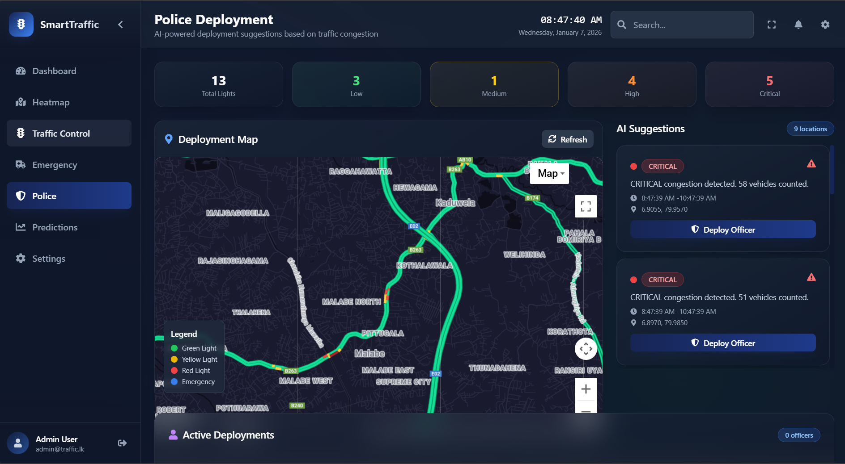
Real-Time Traffic Monitoring, Prediction, and Emergency Path Optimization (Demo)
IT22560308 | Lakshan W V D | 25-26J-300
07/01/2026
10

Slide 11



Bambarandage T.B.M.S
BANDARA S.W.G.B.M.T
IT22638304
IT22006370
Specialization - Information Technology
Specialization - Information Technology
Multimodal Explainable Leprosy Diagnostic System
INTELIGENT VIOLATION MANAGEMENT & TASK AUTOMATION
IT22006370 | Bambarandage T.B.M.S | 25-26J-196
06/01/2026
14
IT22638304| BANDARA S.W.G.B.M.T | 25-26J-300
06/01/2026
11

Slide 12
INTELIGENT VIOLATION MANAGEMENT & TASK AUTOMATION
How the Solution will address the Sub-Problem / Prototype
User Requirements addressed by the solution
Automates police fine handling process from data entry to notification
Eliminates manual fine calculation by using violation based rules
Eliminates manual fine calculation by using violation based rules.
Stores all fine records securely in a central database
Quick and easy fine issuing for police officers
Accurate and consistent fine calculation
SMS notification to offenders after fine issuance
Ability to identify repeated offenders using NIC number
IT22638304| BANDARA S.W.G.B.M.T | 25-26J-300
06/01/2026
12
Notes:
6

Slide 13
INTELIGENT VIOLATION MANAGEMENT & TASK AUTOMATION
Police users found the system easy to understand and use
Simple and user-friendly police interface
Fine issuing process is faster compared to manual methods
Heatmap visualization to identify high-risk violation areas
User Feedback on Prototype
Design Excellence/ Contribution
Heatmap helps identify violation-prone areas clearly
License verification using NIC to view fine history
Data driven approach to support police decision making
SMS alerts improve communication with offenders
IT22638304| BANDARA S.W.G.B.M.T | 25-26J-300
06/01/2026
13
Notes:
7

Slide 14
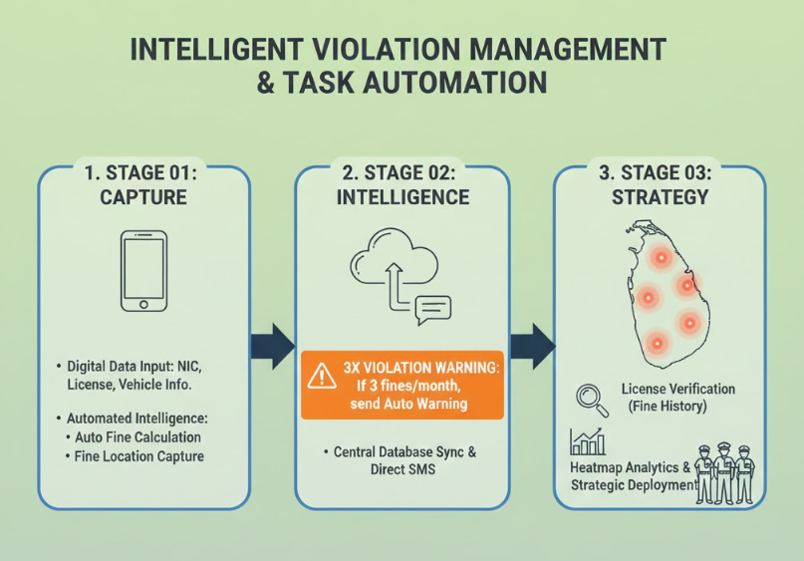
INTELIGENT VIOLATION MANAGEMENT & TASK AUTOMATION
IT22638304| BANDARA S.W.G.B.M.T | 25-26J-300
06/01/2026
14

Slide 15

Wanniarachchi WADP
IT22601056
Specialization - Information Technology
AI Powered CHATBOT with Voice Recording system
IT22601056 | wanniarachchi w.a.d.p. | 25-26J-300
07/01/2026
15

Slide 16
AI Powered CHATBOT with Voice Recording system
How the Solution will address the Sub-Problem
/ Prototype
User Requirements addressed by the
solution
Direct Web Speech Integration: Eliminates Manual Processing Latency by converting speech to text in real-time, replacing slow handwriting
Privacy by Design (Local Storage): Solves Server-Side Privacy Risks by processing and storing data entirely within the browser
Regex Fixer & Contextual AI: Overcomes Keyword Matching Limitations by understanding the user's intent even if they make spelling errors (e.g., "Lyson")
Multilingual Bridge (Google API): Breaks the Language Barrier by translating Sinhala queries to English for processing and returning answers in Sinhala
Instant Support: Provides 24/7 real-time answers to user queries.
User-Friendly Interface: Simplifies communication through an intuitive chat UI
Automated Guidance: easy Helps users navigate the system and need low of knowlage.
Accessibility: Fulfils the requirement for providing legal information in the user's native language
Easy Retrieval: Allows quick access to search and view past records usually users
IT22601056 | wanniarachchi w.a.d.p | 25-26J-300
07/01/2026
16

Slide 17
AI Powered CHATBOT with Voice Recording seystem
Fast Response Times Positive feedback on the Chat Box's ability to provide instant assistance.
Integrated Interface
Clean Chat Box UI built for seamless user interaction and real-time support..
Structured Data Logging
Robust Entry Record system ensuring accurate and secure data management.
User Feedback on Prototype
Design Excellence/ Contribution
Ease of Use
Users found the Entry Record interface intuitive for logging and retrieving information
API-Driven Backend: Well-structured communication between the chat interface and the record-keeping database
Semantic Search
all-MiniLM-L6-v2
Clarity of Data
Users appreciated the clear organization of recorded entries for better traceability.
IT22601056 wanniarachchi w.a.d.p| | 25-26J-300
06/01/2026
17
Notes:
7

Slide 18
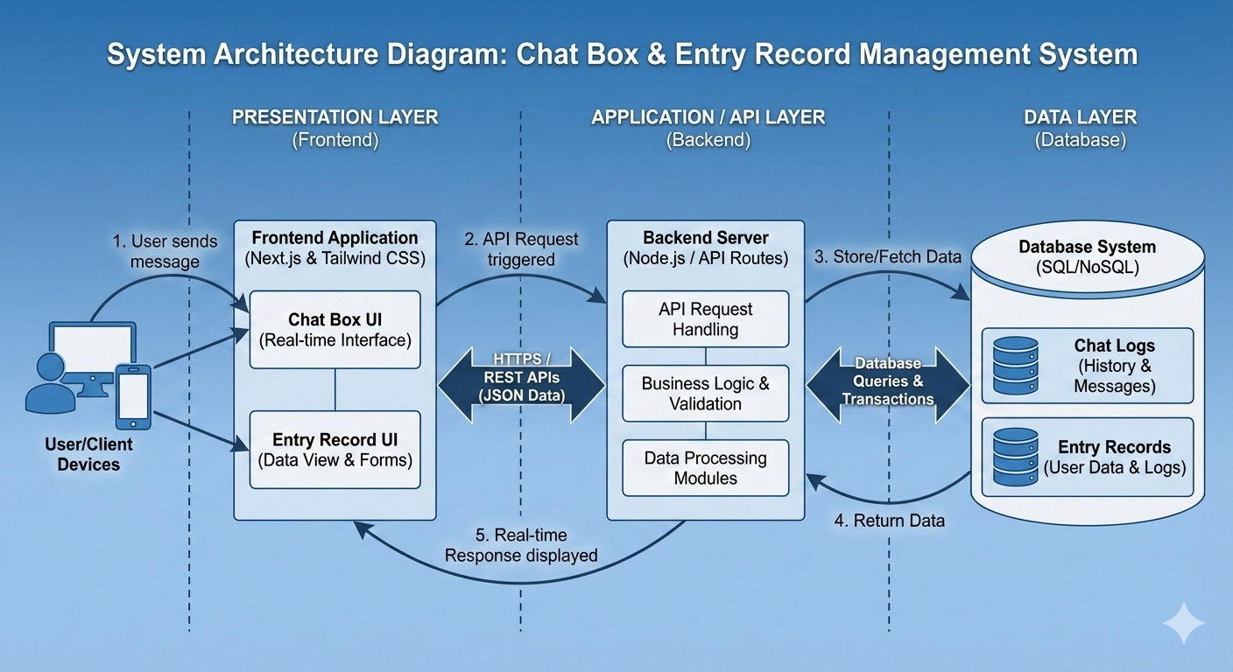
AI Powered CHATBOT with Voice Recording system
IT22601056 | wanni arachchi.| 25-26J-300
07/01/2026
18

Slide 19
COMMERCIALIZATION
PLAN
IT22313270 | Induwara YGY| 25-26J-300
06/01/2026
19

Slide 20
COMMERCIALIZATION PLAN
12 month
24 month
48 month
Phase 1
Phase 2
Phase 3
Negotiation price
Negotiation price
Negotiation price
Access to all features
Access to all features
Access to all features
Provide as a pilot project for specific area in Sri Lanka
Testing with whole country parallely with the current non-digitalize procedure
As a stable project, replace existing procedure and exists this project as a Sri Lanka Traffic Police violation
06/01/2026
20

Slide 21
Thank You!
06/01/2026
21

